Slide 1
A Day in the Life of a Specimen
A choose your own adventure from the North Carolina State Laboratory of Public Health!
Click Here to Begin!

Slide 2
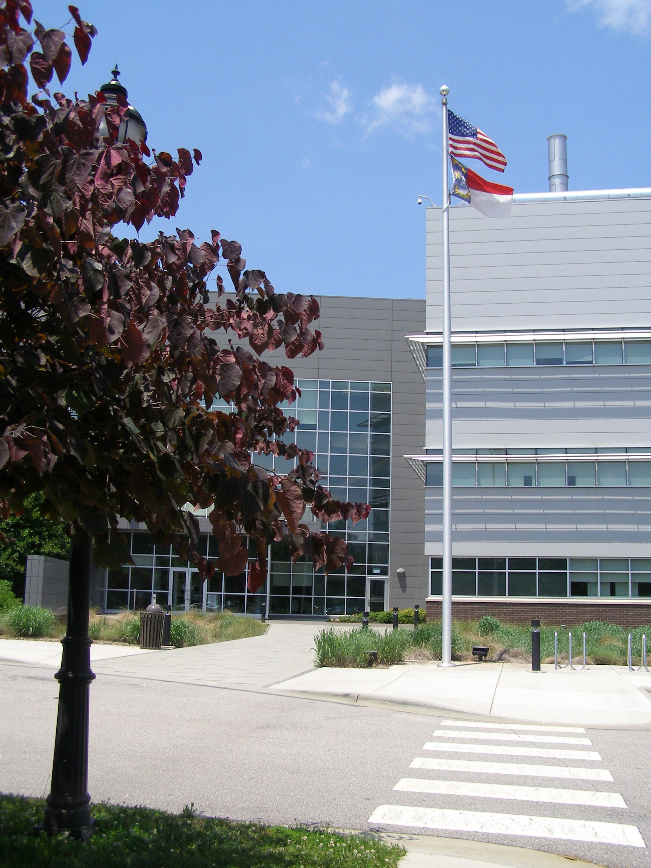
Welcome to the North Carolina State Laboratory of Public Health
This choose your own adventure will let you learn more about this public health entity as you navigate through some different types of testing we perform at the lab and possible outcome scenarios of the lab results.
At the State Laboratory of Public Health, we test for many different types of public health concerns to help North Carolina citizens maintain happy, healthy lives. Just click on the red boxes to select your choices and have fun!
Many of the diseases that we may be test for at the lab are caused by viruses or bacteria. Would you like to learn more about viruses and bacteria or jump to the adventure?
Click to learn about Viruses and Bacteria
Let’s start the Adventure

Slide 3



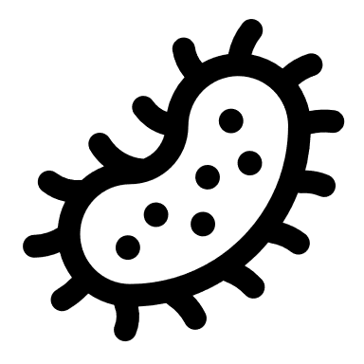
Viruses and Bacteria are Microorganisms
Many illnesses are caused by either a viral or bacterial infection.
Viruses are considered non-living because they are not made of cells. However, they do contain genetic material (DNA or RNA), can reproduce in a host cell and even evolve or mutate. They are much smaller than bacteria, so you cannot see them with a common microscope.
Bacteria were the first organisms on Earth and most of them are harmless or even beneficial to life. They are simple, single celled organisms and are usually smaller than human cells. Some can multiply rapidly inside of your body and make you very sick. We use common microscopes and other tests to help us identify bacteria.
Both have evolved to attack specific types of cells, so they are “host specific” .
Microorganisms are why it’s so important to wash you hands!
Click Here to Start the Adventure

Slide 4


Let’s Get Started on This Adventure!
At the State Laboratory of Public Health, we test clinical and animal specimens or environmental samples. Clinical specimens only come from humans. Environmental samples may come from the air, soil, water or other locations.
Are you ready to begin? Pick the type of specimen for testing in the laboratory.
Clinical or Animal Specimen
Environmental Sample

Slide 5


Clinical and Animal Specimens
Most of the specimens we receive each day are clinical specimens from humans. These tests may be for newborn screenings, infectious diseases (like COVID-19, HIV or TB) or even identification and surveillance of microorganisms using genetic material (DNA or RNA).
Some specimens may come from animals for rabies testing.
Decide which type of specimen to collect for testing.
Human Specimen
Animal Specimen

Slide 6



Environmental Samples
Environmental samples may come from many different sources. Our labs test things like drinking water, waste-water, Grade A milk, and for radioactivity or chemicals in air, soil and food.
Drinking water must be safe from toxic chemicals and dangerous bacteria. Not only public water supplies, but every home with a well for water will have the water safety tested at some point.
Homes built before the 1970’s usually were painted with paint that contained lead. Lead can be an environmental toxin, especially to young children.
Choose between living in a home that was built in the 1960’s, 1990’s or to have a glass of milk.
1960’s
Home
1990’s
Home
Milk, Yum

Slide 7
Pour the Glass of Milk
Don’t cry over this spilled milk!
Did you know that most of the milk people drink is called “Grade A” milk? This standard is set by the FDA (Food and Drug Administration). Grade B milk can be used for manufacturing dairy products like cheese and butter.
Grade A milk has earned that letter grade because it’s the safest to consume because of the sanitary conditions it was produced by.
This glass of milk was tested at the State Lab and had some potentially harmful bacteria! This spilled milk is best left alone, it has earned a failing grade.
Click Here

Slide 8

Human Clinical Specimen
Patient 1 is 27 years old and emigrated from another country 11 months ago. The patient has been coughing for months, has had a fever for 3 weeks and a loss of appetite.
Patient 2 is 7 years old and has never had childhood vaccinations. The child has itchy blisters, a fever and feels tired.
Patient 3 is 73 years old and lives in a nursing home. Patient 3 has experienced severe stomach pain, nausea and vomiting.
Will you pick patient 1, patient 2, or patient 3 to learn more about?
Patient 1
Patient 2
Patient 3

Slide 9

Patient 1
Patient 1 has classical symptoms of a person with a Tuberculosis (TB) infection.
TB is caused by a bacterium called Mycobacterium tuberculosis. The bacteria usually attack the lungs but can attack any part of the body such as the kidney, spine and brain.
TB germs spread easily through the air.
Lucky for this person, TB is treatable and this patient was able to be cured!
Click Here

Slide 10

Patient 2
Patient 2 has common symptoms of chickenpox, which is highly contagious.
This specimen tested positive for the varicella-zoster virus that causes chickenpox.
There is a vaccine for chickenpox that is 90% effective at preventing it.
Chickenpox is usually mild in healthy children but can be life threatening.
Patient 2 had to miss 8 days of school but will recover and may have scars on the skin. Luckily, this patient did not spread the virus to others.
Click Here

Slide 11

Patient 3
You may hear of these symptoms (stomach pain, vomiting and diarrhea) associated with illness terms like “food poisoning” or “the stomach bug”.
In fact, noroviruses are the leading cause of foodborne illness although other germs can also cause these symptoms. It is very contagious and can be transmitted by contaminated food, water, surfaces or directly from a person.
At the State Laboratory of Public Health, genetic material is used to determine if a foodborne illness is the cause of these symptoms. This information is very helpful in determining the source of the outbreak and preventing further spreading.
The lab testing shows that this patient did get norovirus from eating contaminated food in the nursing home. While unpleasant, this patient did recover!
Click Here

Slide 12

Animal Specimen
Rabies is a viral disease that is usually fatal in affected mammals; but there is also a vaccine for prevention! Some animals are more likely to spread the disease and include skunks, racoons and bats.
This animal specimen came from a cat in Pender County and brought to us for testing. The cat was caught by NC Wildlife officers because it was having very aggressive behavior toward customers in a grocery store parking lot and scratched a man trying to protect his child. The cat eventually went into a coma before it died.
Do you think this animal had rabies?
NO
YES

Slide 13
You picked no, the cat did not have rabies.
The deceased animal head was sent to the lab for testing because the brain must be inspected to determine if the animal had rabies.
Unfortunately for this cat, it never had a vaccine to protect against rabies and was bitten by a rabid skunk. The lab was able to confirm the animal did have rabies and this information is important so that the human who was scratched can be treated.
The cat showed some classical symptoms of rabies: making excess of saliva, extreme aggressiveness, unusual behavior, seizures, coma and death.
Click Here

Slide 14
You picked yes, the cat did have rabies.
Congratulations! You are right!
The deceased animal head was brought to the lab for testing because the brain must be inspected to determine if the animal had rabies.
Because rabies was confirmed by the lab, the person scratched will require treatment to stay healthy.
Unfortunately for this cat, it had some classical symptoms of rabies. It never had a vaccine to protect against rabies and was bitten by a rabid skunk encounter. Symptoms can include making lots of saliva, extreme aggressiveness, unusual behavior, seizures, coma and death.
Click Here

Slide 15

1992 Home with Well Water
Your family just bought a home that was built in the 1990’s. Because of the date it was built, your area did not have a public water supply and homes had wells as the only source of fresh water.
To pass inspection for the home sale, the well water must be sent to the lab to ensure the safety of the water supply.
The lab found levels of coliform bacteria from the first test. This requires the well to be treated and retested.
Luckily for your family, your well water passed inspection after it was treated!
Click Here

Slide 16

1963 Home with Lead Paint
Your family lives with grandparents in a home built in 1963. Before 1978 homes were painted with paint that contained lead.
When children are around 1 year old, doctors take a sample of blood to determine if the levels of blood lead are safe.
Lead is a toxic metal that can cause severe mental impacts and even death, especially in young children.
The lab results show your brother has blood lead levels that are just slightly higher than the safe level. A doctor will contact the family to help you learn more about what to do to keep your family healthy.
Environmental samples from around the home will also be tested to determine where the lead came from to prevent further exposure.
Click Here

Slide 17


The End! Thank You for Participating!
Thank you for participating and we hope you enjoyed this choose your own adventure made by the North Carolina State Laboratory of Public Health.
You may want to start over with different choices to learn more about some different types of specimens we test.
If you would like to know more about what we do, please visit our website: N.C. DPH: State Laboratory of Public Health (ncdhhs.gov)
Further health information on these topics can be found at the Center for Disease Control: Health Topics (cdc.gov)
Video: What is Public Health?
Article: The Many Career Pathways in Public Health Laboratory Science
Click Here to Return to the Start Page
DHHS is an equal opportunity employer and provider 12/22

